Slide 1
SIF In-depth Investigation
Indiana Harbor: Near Miss R3 Carrier Beam 10/14/2024
Brian Warnock
December 6th, 2024

Slide 2

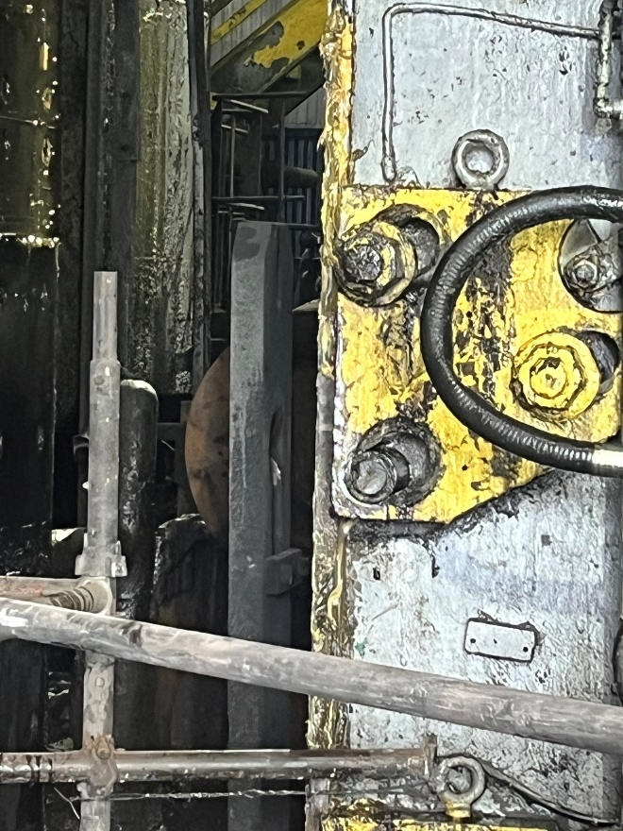
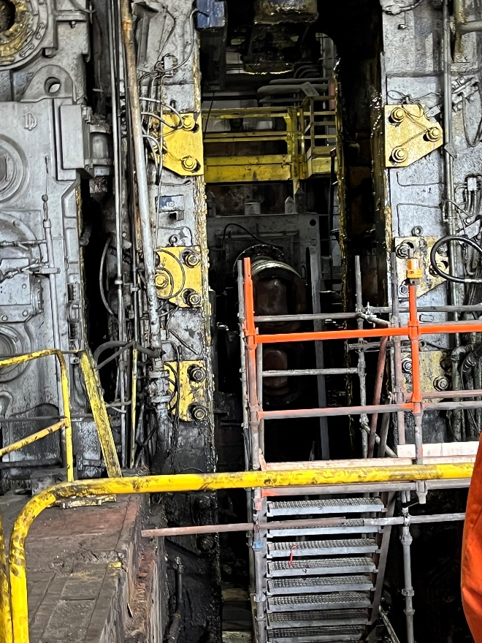
SIF Incident Description
At approximately 13:03, R3 Delivery Carrier Beam (with designed keeper still installed) fell into the R3 Mill Pit onto the sled and scaffold platform. No Team members were working in the pit at the time. However, several contractor employees were working in the pit throughout the morning in preparation for the removal and replacement of the R3 Stripper Guide Box change out.
R3 Carrier Beam Inside Back Up Pit with Keeper Still Installed on Link Arm

Slide 3
Key findings from in-depth investigation
  R3 Backup Rolls were removed from the mill stand on the previous turn for the outage work at R3.
  R3 Top Backup Roll Balance was isolated at the valve stand and left in the fully raised position to allow for clearance for the Stripper Guide Box changeout prior to the planned work. The R3 Top Roll Balance was able to move above the normal stop position when the Backup Rolls are installed.
  The B Hydraulic System was shutdown and isolated for a separate planned job after the above R3 Stripper Guide Box work had commenced. The hydraulic isolation valve at the R3 valve stand is believed to have been slowly bleeding through allowing the cylinder fluid to vacate the pipe back through the feed to the valve due to the system being shutdown.
  Upon video review of the incident, the Delivery Roll Balance Carrier Beam was hung up in the mill window housing due to being wedged against the top mill spreader and mill posts and the yoke unknowingly drifted down over the course of two hours.
  The Carrier Beam and Link Arm were forced away from the Mill Center Line allowing the link arm stop to clear the cylinder lifting point (Yoke). The yoke drifted down but the carrier beam did not.
  Original mill design only incorporated one keeper installed on each link arm for Roughing Mill Stands.
  R3 Carrier Beam weighs approximately 8500 lbs. Wear was measured in the components of the link arm and yoke, however, the measurements do not allow for enough clearance for the link arm to dislodge from the yoke under normal operating conditions.

Slide 4
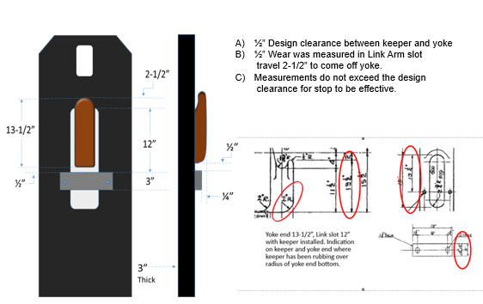
Key Findings
Yoke End/Link Arm Clearance

Slide 5
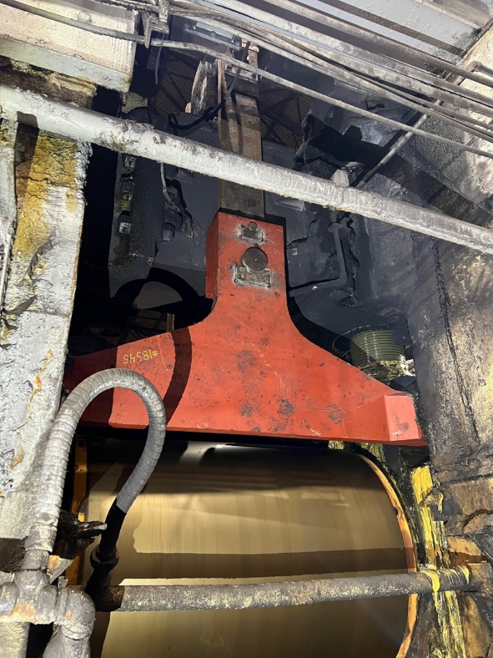
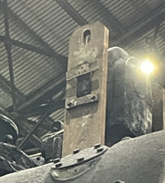
Containment actions
New R3 Delivery Carrier Beam Installed
Additional Keeper welded to Roll Balance Yoke (Cylinder Lifting Point for Carrier Beam)

Slide 6
Corrective actions / preventive actions
Upper Half HOC CAPAs
HOC Level | Action Description | Selected | Due Date
3 | Obtain Budgetary Proposal for an Engineering firm to design upgrades and modifications to the existing Top Roll Balance Carrier Beam System to include: Yoke/Link Connection, Link Arm Tie Bar, Top Chock Stops, Roll Balance Bypass & Safety Stop. | ✔ | Completed
3 | Replace R3 hydraulic isolation valves; Test & tryout R1, R2, R4 & R5-Replace if needed | ✔ | Completed
3 | Install additional keepers to roll balance yoke (cylinder lifting point for carrier beam link arm) as containment. | ✔ | Completed
Lower Half HOC CAPAs
HOC Level | Action Description | Selected | Due Date
2 | Eliminate practice of isolating top roll balance in the upright position without pinning, blocking or cribbing. | ✔ | Completed
2 | Contact all HSM employees on SIF Incident Review SIB and Lockout/Tryout requirements: All energy sources must be controlled including stored energy-gravity. | ✔ | 12/15/24
2 | Establish inspection process for Roll Balance Carrier System in work order system with inspection components. | ✔ | Completed

Slide 7
Key Takeaways and Follow-up Actions
Key takeaways
Hydraulically lifted equipment contains stored energy in the up position and is susceptible to drift from gravity and system pressure loss.
Objects that can drift down must be pinned, blocked, or cribbed as part of LOTO procedure before working on or under.
Follow-up Actions
Action Description
Departments identify tasks that require hydraulic cylinders to be locked in the up (extended) position, susceptible to gravity and pressure bleed. Ensure engineered blocks/pins are included in LOTO procedure to protect against drift.

